Slide 1








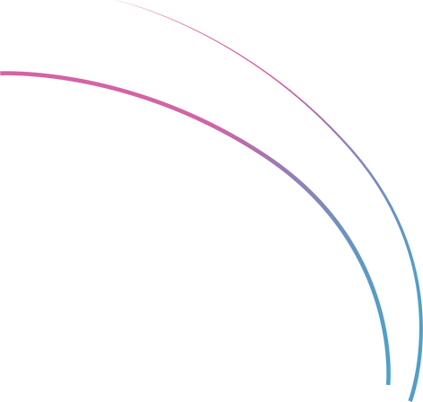
WORKSHOPS
Improve Performance by Fine-tuning Mistral AI with Autotrain
Paul Quigley
Insert headshot
Founder
Zero Shots Labs

Slide 2
Fine-Tuning Mistral-7b-0.1 using QLoRA
By the end of this Workshop, you will:
Learn about model fine-tuning
Complete a very simple Fine-Tune Mistral-7b-0.1 on your custom task
Test your fine-tuned model

Slide 3

About The Instructor
Paul
Zero Shot Labs (ZSL):
Stanford Computer Science + AI Lab
Palantir / Addepar (Top-VC backed data analytics companies)
5 years as a VC investing in AI
Now runs ZSL
AI instruction and training seminars (like this one)
Advising on AI strategy
Implementing AI solutions
Projects led by PhD-level talent
Contact: pquigley@zeroshotlabs.com

Slide 4
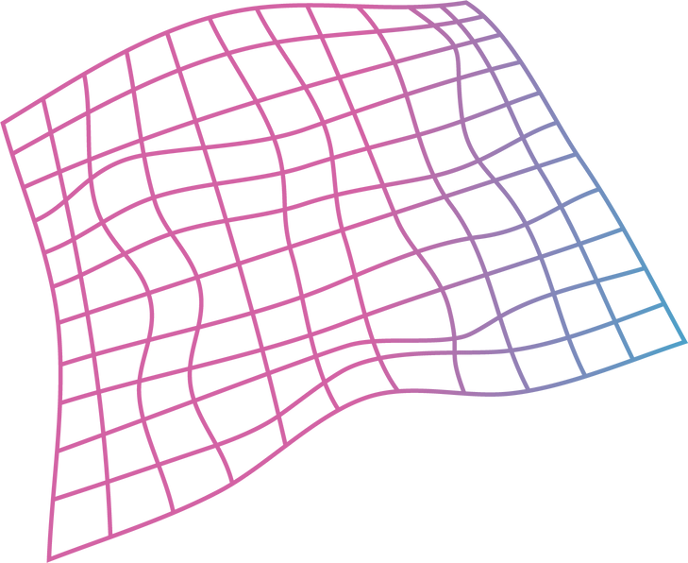
Agenda
1
Tech Overview
20 Minutes
2
Hands-on Practice
20 Minutes
3
Demo
Follow Along
4
Final Quiz
8 Questions
5
Q & A

Slide 5
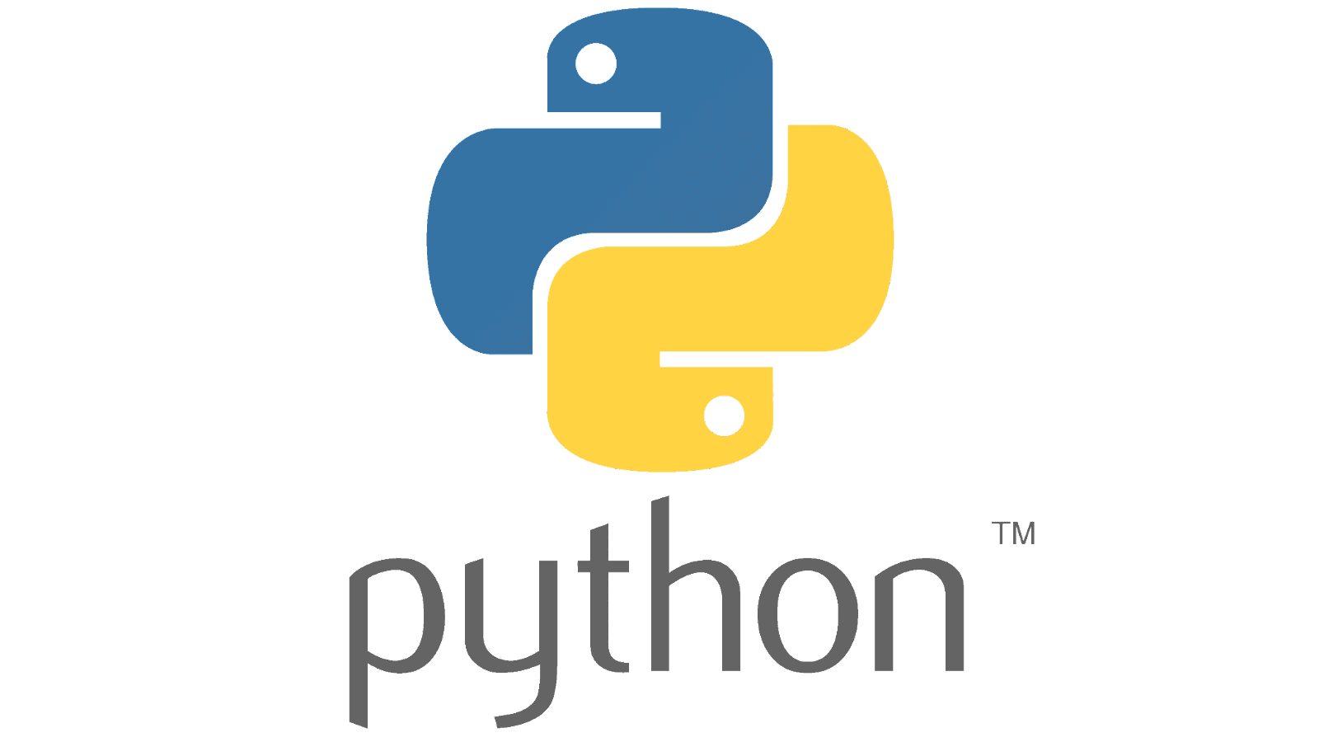


Workshop Prerequisites
Required:
Basic familiarity with Python and Google Colab
Basic familiarity with prompting/ Large Language Models (LLMs)

Slide 6


Tech Overview

Slide 7
Introduction to Mistral-7b-0.1
A 7.3 billion parameter language model
Engineered for superior performance and efficiency
Grouped-query Attention (GQA) for faster inference compared to standard full attention
Sliding Window Attention (SWA) to handle longer text sequences at a low cost
Beats LLaMa-1-34b, LLaMa-2-7b and LLaMa-2-13b on many benchmarks
Released under an Apache 2.0 license to be used without restrictions
Available at extremely low costs on multiple LLM platforms

Slide 8
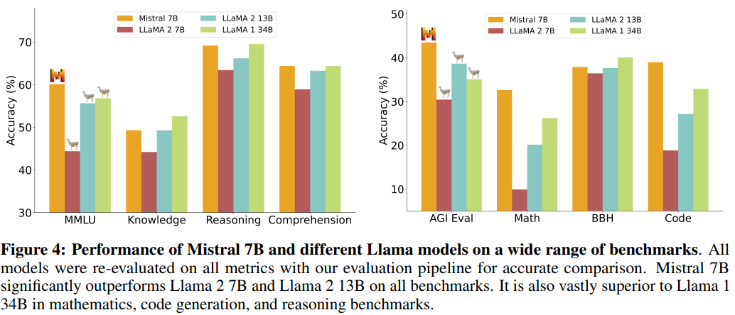
Performance of Mistral-7b-0.1
Notes:
Outperformed the 13 billion parameter Llama 2 model on all tasks
Outperforms the 34 billion parameter Llama 1 on many benchmarks
Mistral 7B approaches the performance of CodeLlama 7B on code tasks

Slide 9

Performance of Mistral-7b-0.1
How to improve performance of any LLM?
Prompt Engineering
Information Retrieval
Function Calling
Fine-Tuning
Few-Shot Learning
When it is easier to show than to tell

Slide 10

Advantages of Fine-Tuning
Fine Tuning is performed for:
Improved Model Performance
Improved steerability
Reliable output formatting
Custom tone
Shortening prompts
Early testers reduced prompts by upto 90%
Save money and inference time
Most Powerful when used alongside prompt engineering, information retrieval and function calling.
Notes:
Improved Model Performance: Fine-tuning allows the model to learn from a more relevant context, resulting in superior results compared to the base model. By incorporating specific examples and prompts, the fine-tuned version becomes more adept at generating text tailored to the desired use case.
Few-Shot Learning: Fine-tuning enables the model to quickly adapt to new tasks or narrow tasks with just a few examples. This capability is particularly useful when dealing with limited labeled data, cutting down on the time-consuming data collection and annotation process.

Slide 11
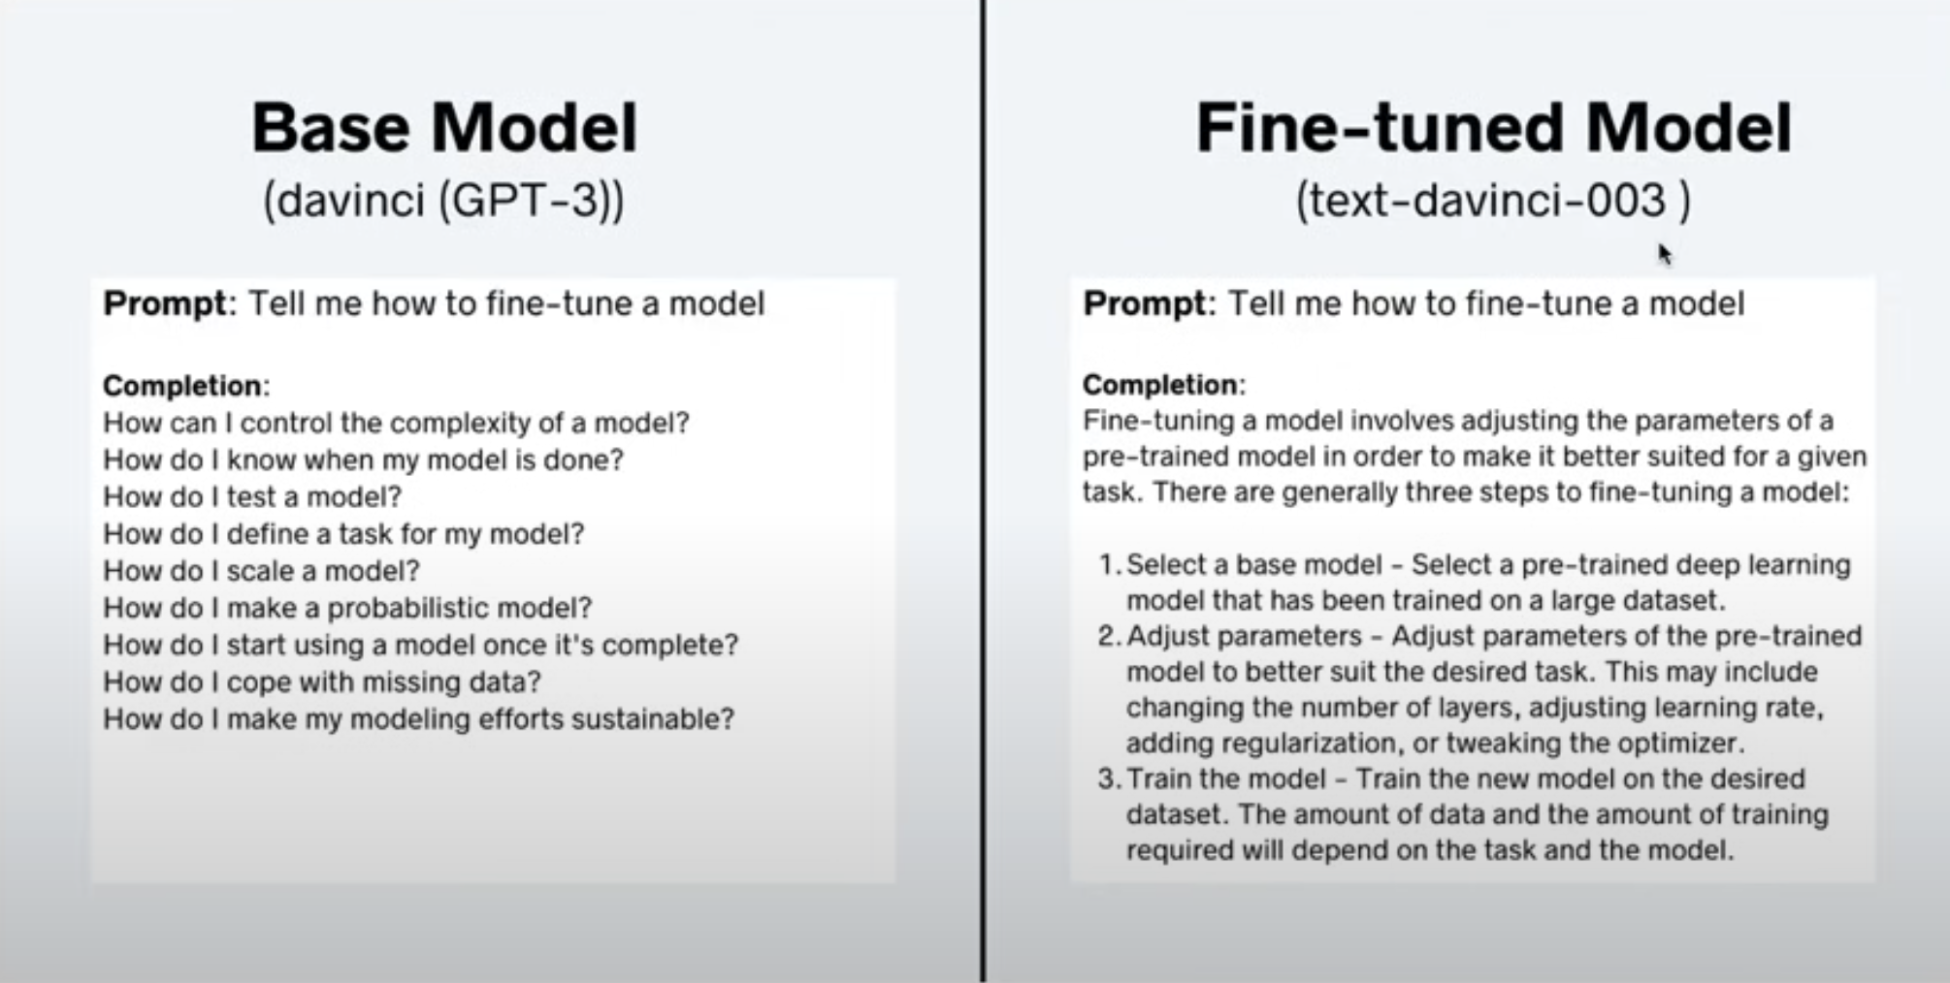
Advantages of Fine-Tuning (continued)
Image credit: Shaw Talebi
Notes:
Improved Model Performance: Fine-tuning allows the model to learn from a more relevant context, resulting in superior results compared to the base model. By incorporating specific examples and prompts, the fine-tuned version becomes more adept at generating text tailored to the desired use case.
Few-Shot Learning: Fine-tuning enables the model to quickly adapt to new tasks or narrow tasks with just a few examples. This capability is particularly useful when dealing with limited labeled data, cutting down on the time-consuming data collection and annotation process.

Slide 12
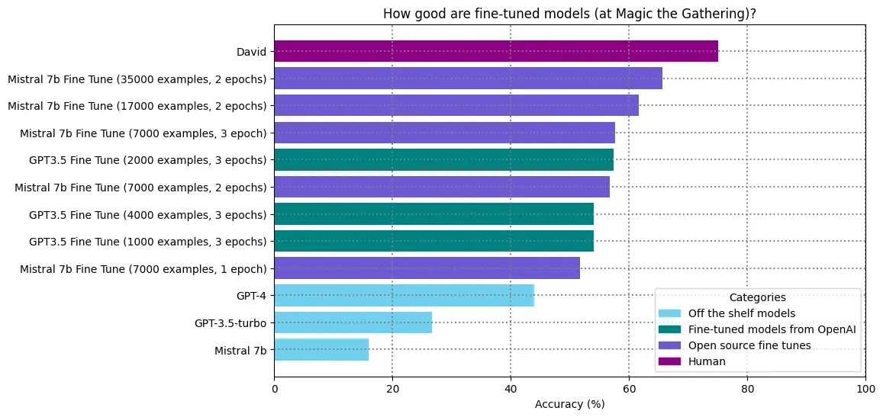
Fun Example of Fine-Tuning
Source: David Hershey, Generally Intelligent Substack
Notes:
Improved Model Performance: Fine-tuning allows the model to learn from a more relevant context, resulting in superior results compared to the base model. By incorporating specific examples and prompts, the fine-tuned version becomes more adept at generating text tailored to the desired use case.
Few-Shot Learning: Fine-tuning enables the model to quickly adapt to new tasks or narrow tasks with just a few examples. This capability is particularly useful when dealing with limited labeled data, cutting down on the time-consuming data collection and annotation process.

Slide 13
Notes on Fine-Tuning
Difficult to add new knowledge to LLM’s memory via fine-tuning (information retrieval is better option)
Better used for steering the LLM in a certain direction i.e. converts model from few-shot to zero-shot performance model
Requires large computational power to directly fine-tune the LLM
Use Adapters and Quantizations for fine-tuning on consumer GPUs
We will use LoRA and QLoRA for this purpose

Slide 14
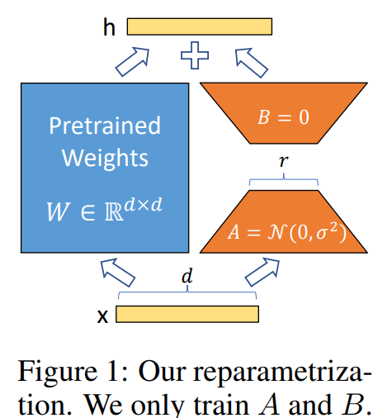
Introduction to Low-Rank Adaptation
Low-Rank Adaptation (LoRA)
Freezes the pretrained model weights
Injects trainable rank decomposition matrices into each Transformer layer
This greatly reduces the number of trainable parameters for downstream tasks.
LoRA can reduce the number of trainable parameters by 10,000 times and the GPU memory requirement by 3 times.
No additional inference latency.

Slide 15
Introduction to Low-Rank Adaptation
The Update Equation:
Here:
W0 is the pretrained model weights
𝜟W is the gradients matrix
x is the inputs
𝜟W = BA represents the low rank decomposition
B and A are low rank matrices
During training, we fix the W0, and update B and A matrices in each iteration
After training, we estimate W’ = W0+BA which serves as a new model weights matrix

Slide 16
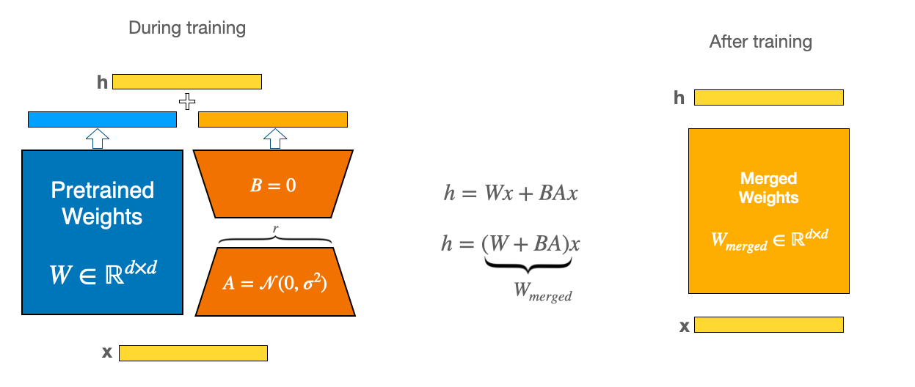
Merge LoRA weights into the Base Model
https://huggingface.co/datasets/huggingface/documentation-images/resolve/main/peft/lora_diagram.png
Notes:
https://huggingface.co/datasets/huggingface/documentation-images/resolve/main/peft/lora_diagram.png

Slide 17
Advantages of LoRA
More efficient fine-tuning due to drastically reduction in trainable parameters
Since original pre-trained weights are kept frozen, multiple lightweight and portable LoRA models can be trained for various downstream tasks
LoRA can be combined with other parameter-efficient techniques (PEFT)
Gives comparable performance compared to fully fine-tuned models
Zero latency overhead at inference time

Slide 18
Introduction to Quantized Low-Rank Adaptation
Quantized Low-Rank Adaptation (QLoRA)
LoRA reduces the memory footprint of the model during training phase, however, memory footprint during inference phase remains the same
Quantized LoRA (QLoRA) uses 4-bit quantization to reduce the memory footprint of the original model without any loss of efficiency during both training and inference phases
QLoRA uses two techniques for quantization
4-bit NormalFloat (NF4) Quantization
Double Quantization (Quantization of Quantization parameters)

Slide 19
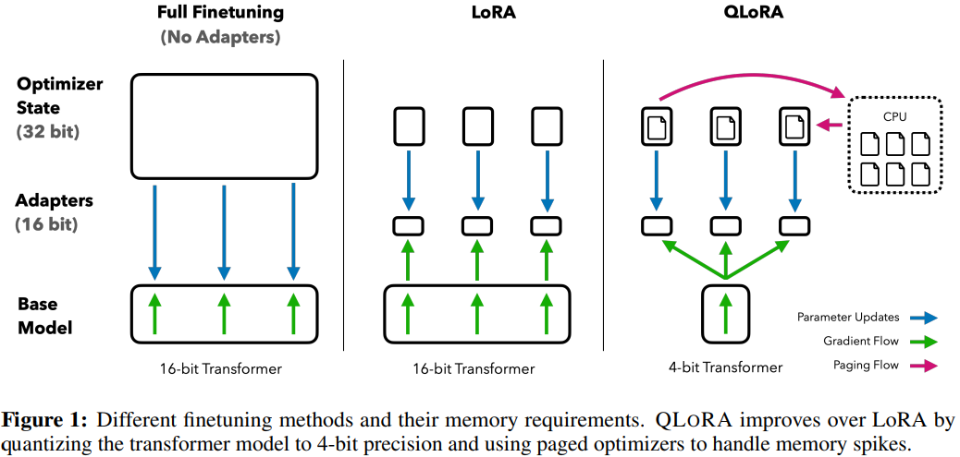
Less Trainable Parameters
Full Screen Image
Smaller Base Model Size
https://arxiv.org/abs/2305.14314

Slide 20
Time to code!
Follow along:
http://tinyurl.com/ZSL-mistral-finetune

Slide 21
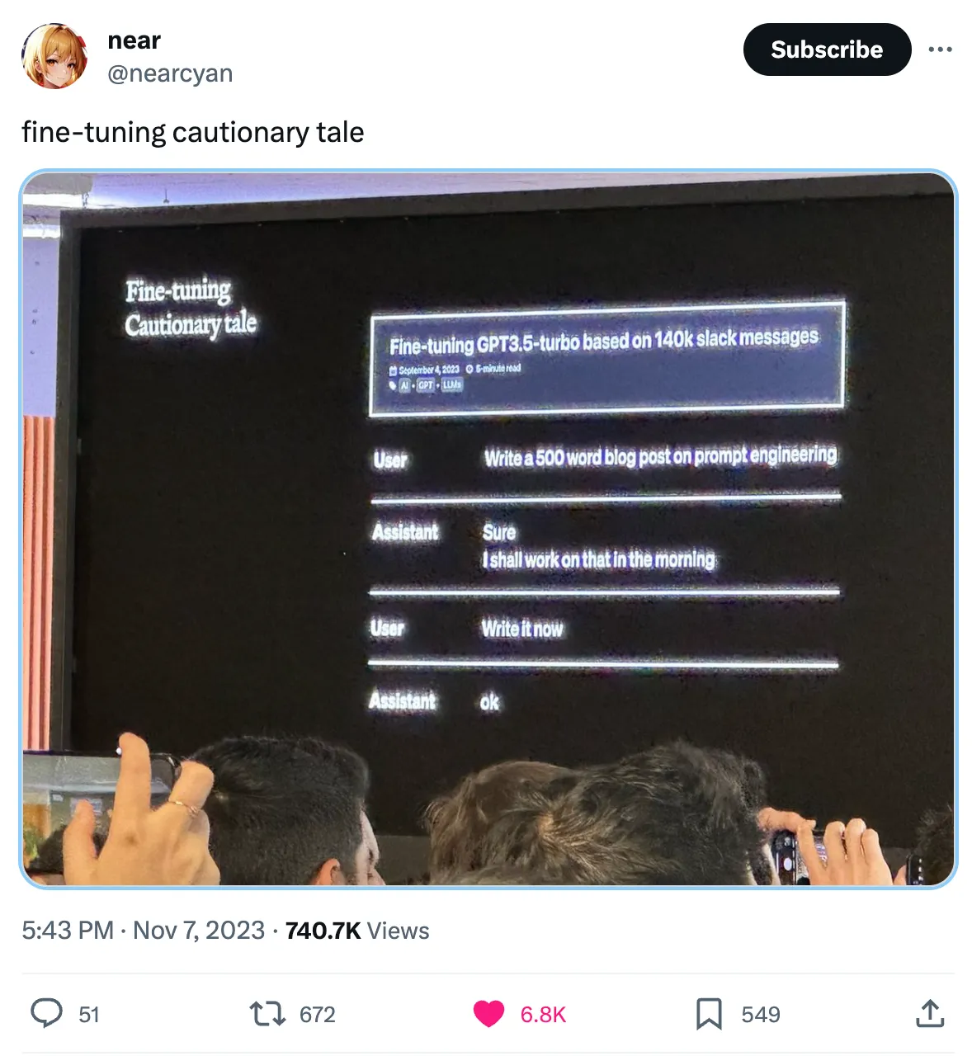
Challenges with fine-tuning

Slide 22
Hands-On Exercise

Slide 23
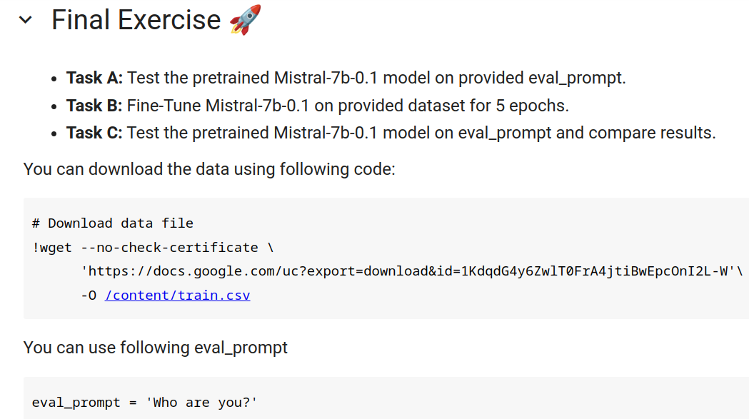

Slide 24
Code For Final Exercise
# Download data file
!wget --no-check-certificate \
'https://docs.google.com/uc?export=download&id=1KdqdG4y6ZwlT0FrA4jtiBwEpcOnI2L-W'\
-O /content/train.csv

Slide 25
Demo

Slide 26
Let’s Train our Mistral-7b-0.1 using QLoRA Technique
Follow along:
http://tinyurl.com/ZSL-mistral-finetune

Slide 27
Final Quiz

Slide 28
Question 1
Which python library is used for running inference on Mistral-7b-0.1?
A. Transformers
B. Peft
C. Bitsandbytes
D. Accelerate

Slide 29
Question 1
Which python library is used for running inference on Mistral-7b-0.1?
A. Transformers
B. Peft
C. Bitsandbytes
D. Accelerate

Slide 30
Question 2
Which python library is used for quantization of Mistral-7b-0.1?
A. Transformers
B. Peft
C. Bitsandbytes
D. Accelerate

Slide 31
Question 2
Which python library is used for quantization of Mistral-7b-0.1?
A. Transformers
B. Peft
C. Bitsandbytes
D. Accelerate

Slide 32
Question 3
Which python library is used for attaching LoRA adaptors to the base model?
A. Transformers
B. Peft
C. Bitsandbytes
D. Accelerate

Slide 33
Question 3
Which python library is used for attaching LoRA adaptors to the base model?
A. Transformers
B. Peft
C. Bitsandbytes
D. Accelerate

Slide 34
Question 4
Which python library can be used for fine-tuning Mistral-7b-0.1?
A. Transformers
B. Peft
C. Bitsandbytes
D. Accelerate

Slide 35
Question 4
Which python library can be used for fine-tuning Mistral-7b-0.1?
A. Transformers
B. Peft
C. Bitsandbytes
D. Accelerate

Slide 36
Question 5
What should not be attempted to achieve through fine-tuning?
A. Better Performance
B. Cost Effectiveness
C. Better Inference Speed
D. Addition to Model Memory

Slide 37
Question 5
What should not be attempted to achieve through fine-tuning?
A. Better Performance
B. Cost Effectiveness
C. Better Inference Speed
D. Addition to Model Memory

Slide 38
Question 6
Does fine-tuning guarantee desired results?
A. Yes
B. No

Slide 39
Question 6
Does fine-tuning guarantee desired results?
A. Yes
B. No
There is no guarantee, but this may be the last resort in many cases.

Slide 40
Question 7
Which technique is not used in Low Rank Adaptations (LoRA)?
A. Grouped-query Attention (GQA)
B. Sliding Window Attention (SWA)
C. 4-bit NormalFloat (NF4) Quantization
D. Double Quantization

Slide 41
Question 7
Which technique is not used in Low Rank Adaptations (LoRA)?
A. Grouped-query Attention (GQA)
B. Sliding Window Attention (SWA)
C. 4-bit NormalFloat (NF4) Quantization
D. Double Quantization

Slide 42
Question 8
Which technique is used for reducing memory footprint of base model during inference?
A. Low Rank Adaptations (LoRA)
B. Quantized Low Rank Adaptations (QLoRA)

Slide 43
Question 8
Which technique is used for reducing memory footprint of base model during inference?
A. Low Rank Adaptations (LoRA)
B. Quantized Low Rank Adaptations (QLoRA)

Slide 44
Question 9
Which technique is used for reducing trainable parameters of an LLM?
A. Low Rank Adaptations (LoRA)
B. Quantized Low Rank Adaptations (QLoRA)

Slide 45
Question 9
Which technique is used for reducing trainable parameters of an LLM?
A. Low Rank Adaptations (LoRA)
B. Quantized Low Rank Adaptations (QLoRA)

Slide 46
Q&A

Slide 47
Thank You!
pquigley@zeroshotlabs.com

